Slide 1
What Could Possibly Go Wrong?
A (mostly) autobiographic account of things that could go wrong in the life of a data scientist fighting for survival in the corporate world.
Pedro Ecija Serrano ¦ www.datadriven.ie ¦ pedroecija@gmail.com

Slide 2
“It ain’t what you don’t know that gets you into trouble. It’s what you know for sure that just ain’t so.”
Mark Twain

Slide 3




The Life of a Data Scientist
Understand the problem
Quickly solve the problem
Deliver the solution and be the hero
Know what you are doing

Slide 4
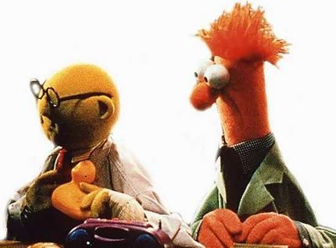
Understanding the Problem
Pedro, the Board wants to know the top 5 customers that we should target.

Slide 5
Understanding the Problem
What 5 customers should we target?
Customer | Expected Income | Probability of Sale
Frodo | €1,072 | 0.9
Boromir | €513 | 0.8
Legolas | €155 | 0.7
Gimli | €75 | 0.6
Aragorn | €306 | 0.5
Pippin | €388 | 0.4
Meriadoc | €827 | 0.3
Gandalf | €2,495 | 0.2
Sam | €10,998 | 0.1
This is where the audience enthusiastically participates.

Slide 6
Understanding the Problem
Customer | Expected Income | Probability of Sale | Probability Weighted Income
Frodo | €1,072 | 0.9 | €964.8
Boromir | €513 | 0.8 | €410.4
Legolas | €155 | 0.7 | €108.5
Gimli | €75 | 0.6 | €45
Aragorn | €306 | 0.5 | €153
Pippin | €388 | 0.4 | €155.2
Meriadoc | €827 | 0.3 | €248.1
Gandalf | €2,495 | 0.2 | €499
Sam | €10,998 | 0.1 | €1,099.8
Choosing Frodo, Boromir, Legolas, Gimli and Aragorn:
Average probability of sale: 0.7
Expected income: €2,121
Probability weighted income: €1,681.7
Choosing Sam, Gandalf, Frodo, Boromir and Meriadoc:
Average probability of sale: 0.46
Expected income: €15,905
Probability weighted income: €3,222.1

Slide 7
Understanding the Problem
Is there a right answer?
Did we really understand the problem?
Why can stakeholders never give us enough context?
It is important to know what use will be given to our output.
What is the big picture?
What are we trying to achieve?
What if we find another way to do it?

Slide 8
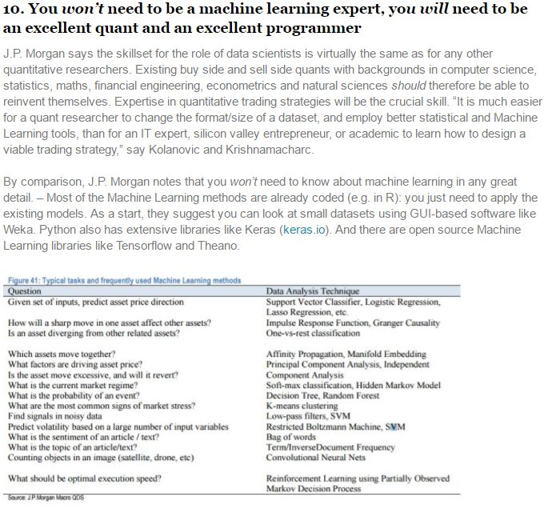
Know what you are doing
http://news.efinancialcareers.com/ie-en/285249/machine-learning-and-big-data-j-p-morgan/

Slide 9
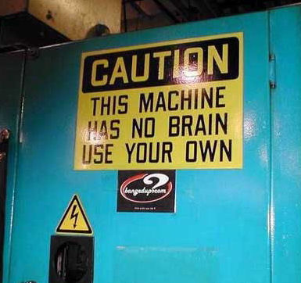
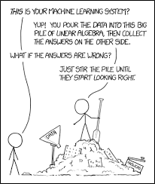
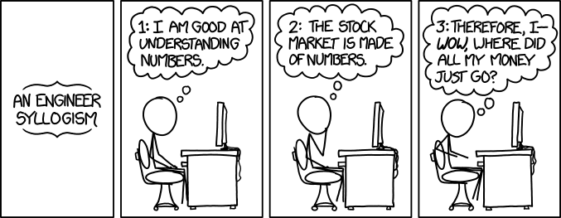
Know what you are doing
https://xkcd.com/1570/

Slide 10
Solving the Problem
How do you allow for impossible events?
And what is, actually, impossible?
‘that never really happens’
‘It makes no sense, it cannot happen’
‘That is just mathematically impossible’
We will not mess with the mathematically impossible…

Slide 11
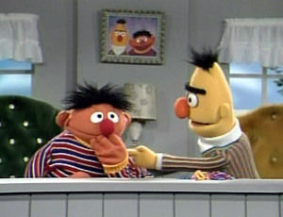
‘That never really happens’
Once upon a time in 2007…
Our profit testing assumes equity growth is always positive, should we also test when it is not?
No, equities always grow at positive rates in the long term.

Slide 12
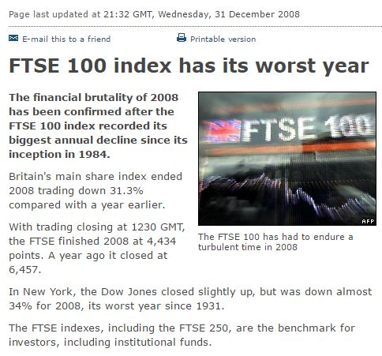
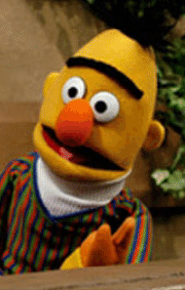
‘That never really happens’
Later, the following year…
BBC: http://news.bbc.co.uk/2/hi/business/7805008.stm

Slide 13
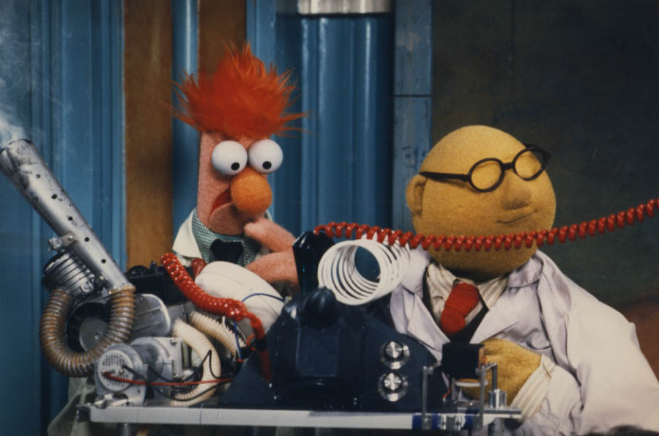
‘It makes no sense, it cannot happen’
Negative interest rates? That is just stupid. They are already at their lowest ever.
Once upon a time in 2010…
This 20 year simulation considers only positive interest rates, should we think of negative too?

Slide 14
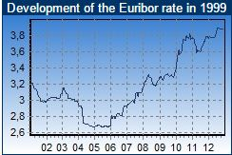
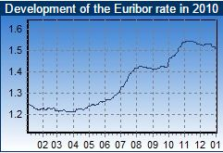
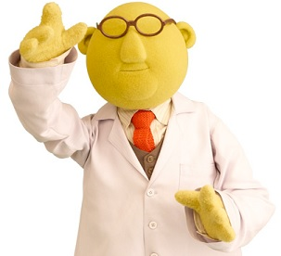
‘It makes no sense, it cannot happen’
You see? Over 2.6% in 1999 and at least 1.2% now in 2010. It cannot get lower than that. Negative rates make no economic sense.

Slide 15
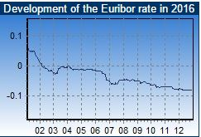
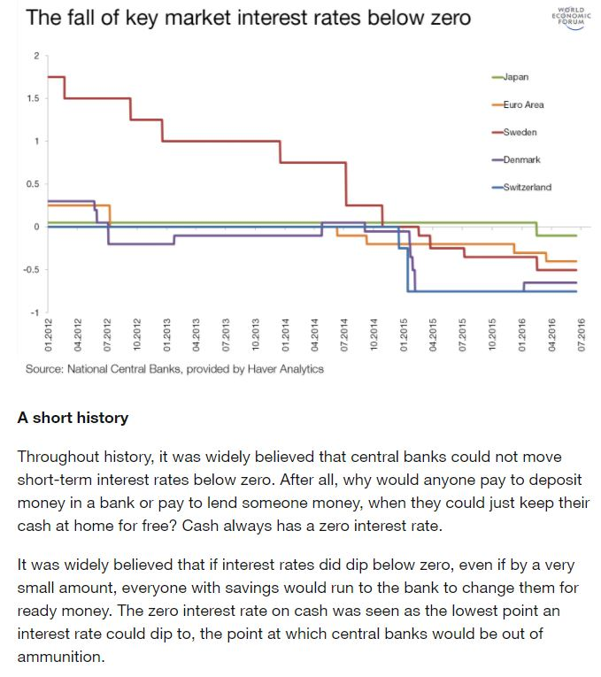
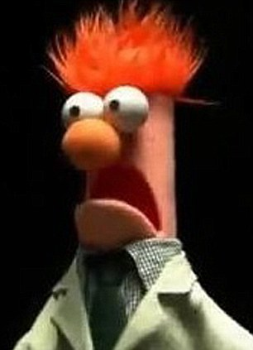
‘It makes no sense, it cannot happen’
But in 2016…
World Economic Forum: https://www.weforum.org/agenda/2016/11/negative-interest-rates-absolutely-everything-you-need-to-know/

Slide 16

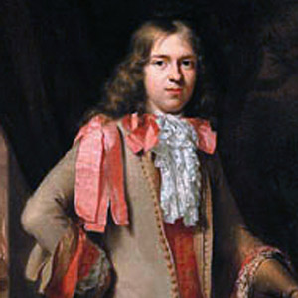
Solving the Problem
Be sceptical and even question your own wisdom.
Consider scenarios beyond what seems possible. What is not possible under current circumstances could easily change.
Prepare to be laughed at. They will think that you are a Muppet!
1696 – Willem de Vlamingh is utterly convinced that all swans are white. Everybody knows it as there have not been any reports of non-white swans in 4,000 years.
1697 – Willem de Vlamingh tells the world that swans can actually be black. He has seen them in Australia.
2017 – Would your model consider the possibility that a swan may be pink? What if I told you I have seen one?

Slide 17
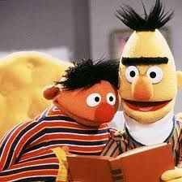
Deliver the Solution
Look at this, we are losing customers. Do you think we could price our book more competitively?
I will see what I can do before I go on holidays.

Slide 18
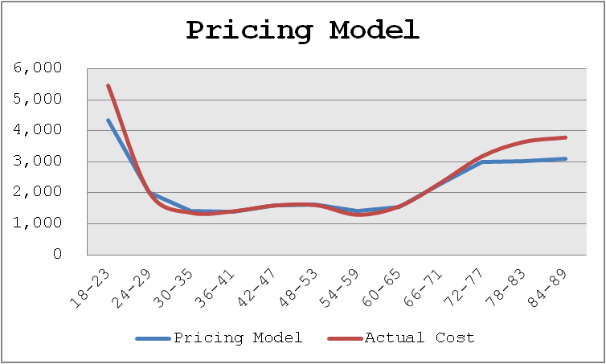
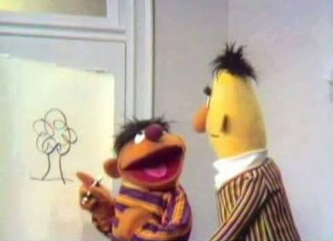
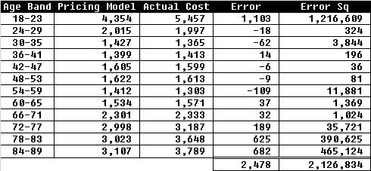
Deliver the Solution
That looks really good, I will take it to the Board while you are away.
Sure, just remember it does not work well with the young and the elderly but works well in average.

Slide 19
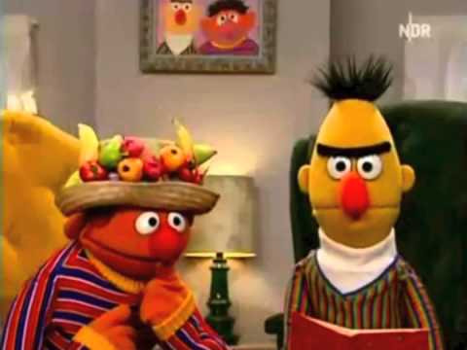
Deliver the Solution
The Board considered it while you were on holidays and decided to focus on young and elderly customers, as that is where we can be more competitive.

Slide 20
Deliver the Solution
Could we have communicated the model’s shortcomings more clearly?
Should we have insisted on presenting the model ourselves?
Should we have capped the model so that we do not produce results where the error is too high, even if it works well on average?
Why can they never listen to the detail? That’s where the devil is!
And the audience cheerfully participates once again

Slide 21
“All you need in life is ignorance and confidence, and success is sure.”
Mark Twain

Slide 22
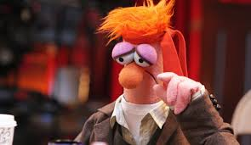
And Be the Hero

